Slide 1

CHAPTER 11
Data Structure
Notes:
1.#

Slide 2
Objectives
After studying this chapter, the student should be able to:
Define a data structure.
Define an array as a data structure and how it is used to store a list of data
items.
Distinguish between the name of an array and the names of the elements in an array.
Described operations defined for an array.
Define a record as a data structure and how it is used to store attributes
belonging to a single data element.
Distinguish between the name of a record and the names of its fields.
Define a linked list as a data structure and how it is implemented using
pointers.
Describe operations defined for a linked list.
Compare and contrast arrays, records, and linked lists.
Define the applications of arrays, records, and linked lists.

Slide 3
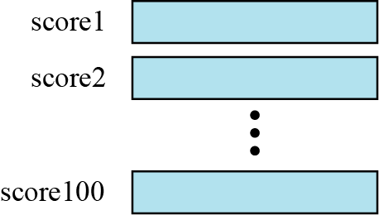
11-1 ARRAYS
Imagine that we have 100 scores. We need to read them, process them, and print them. We must also keep these 100 scores in memory for the duration of the program. We can define a hundred variables, each with a different name, as shown in Figure 11.1.
Figure 11.1 A hundred individual variables

Slide 4
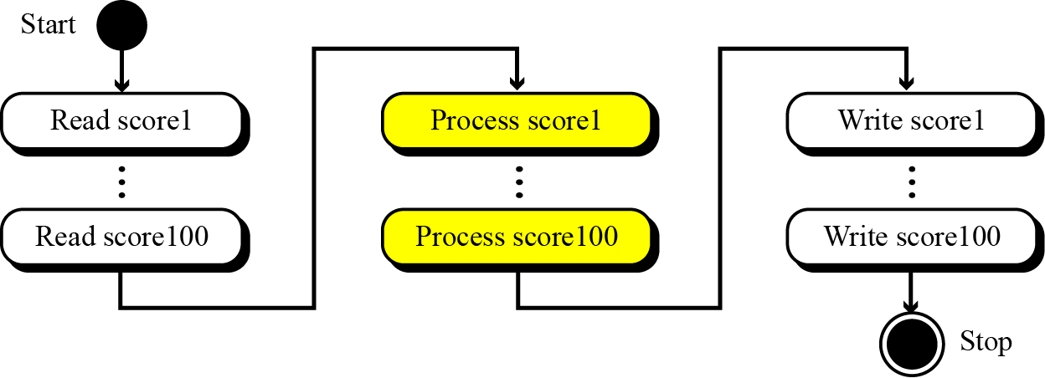
But having 100 different names creates other problems. We need 100 references to read them, 100 references to process them, and 100 references to write them. Figure 11.2 shows a diagram that illustrates this problem.
Figure 11.2 Processing individual variables

Slide 5
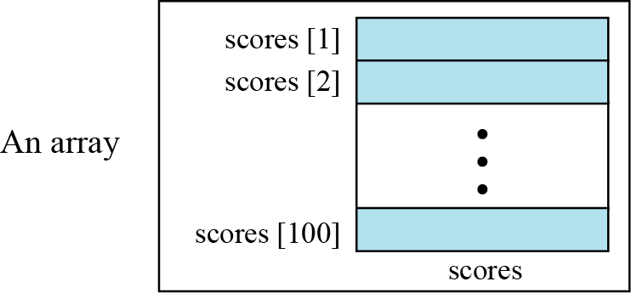
An array is a sequenced collection of elements, normally of the same data type, although some programming languages accept arrays in which elements are of different types. We can refer to the elements in the array as the first element, the second element, and so forth until we get to the last element.
Figure 11.3 Arrays with indexes

Slide 6

We can use loops to read and write the elements in an array. We can also use loops to process elements. Now it does not matter if there are 100, 1000, or 10,000 elements to be processed—loops make it easy to handle them all. We can use an integer variable to control the loop, and remain in the loop as long as the value of this variable is less than the total number of elements in the array (Figure 11.4).
We have used indexes that start from some modern languages such as C, C++, and Java start indexes from 0.

Slide 7
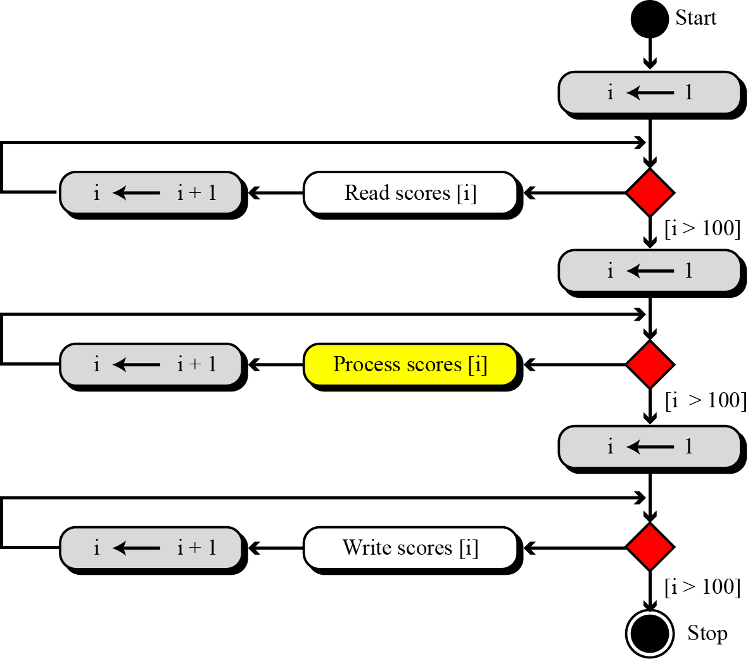
Figure 11.4 Processing an array

Slide 8
Example 11.1
Compare the number of instructions needed to handle 100 individual elements in Figure 11.2 and the array with 100 in Figure 11.4. Assume that processing each score needs only one instruction.
Solution
In the first case, we need 100 instructions to read, 100
instructions to write, and 100 instructions to process. The
total is 300 instructions.
In the second case, we have three loops. In each loop we have
two instructions, for a total of six instructions. However, we
also need three instructions for initializing the index and three instruction to check the value of the index. In total, we have
twelve instructions.

Slide 9
Example 11.2
The number of cycles (fetch, decode, and execute phases) the computer needs to perform is not reduced if we use an array. The number of cycles is actually increased, because we have the extra overhead of initializing, incrementing, and testing the value of the index. But our concern is not the number of cycles: it is the number of lines we need to write the program.

Slide 10
Example 11.3
In computer science, one of the big issues is the reusability of programs—for example, how much needs to be changed if the number of data items is changed. Assume we have written two programs to process the scores as shown in Figure 11.2 and Figure 11.4. If the number of scores changes from 100 to 1000, how many changes do we need to make in each program? In the first program we need to add 3 × 900 = 2700 instructions. In the second program, we only need to change three conditions
(I > 100 to I > 1000). We can actually modify the diagram in Figure 11.4 to reduce the number of changes to one.

Slide 11
11.1.1 Array name versus element name
In an array we have two types of identifiers: the name of the array and the name of each individual element. The name of the array is the name of the whole structure, while the name of an element allows us to refer to that element. In the array of Figure 11.3, the name of the array is scores and name of each element is the name of the array followed by the index, for example, scores[1], scores[2], and so on. In this chapter, we mostly need the names of the elements, but in some languages, such as C, we also need to use the name of the array.

Slide 12
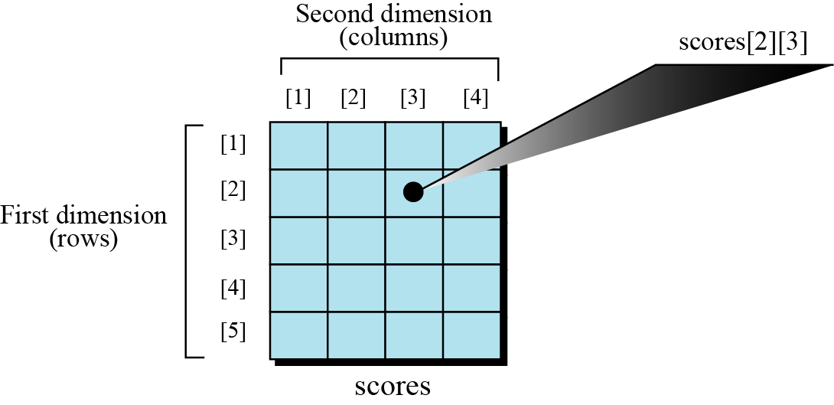
11.1.2 Multi-dimensional arrays
The arrays discussed so far are known as one-dimensional arrays because the data is organized linearly in only one direction. Many applications require that data be stored in more than one dimension. Figure 11.5 shows a table, which is commonly called a two-dimensional array.
Figure 11.5 A two-dimensional array

Slide 13
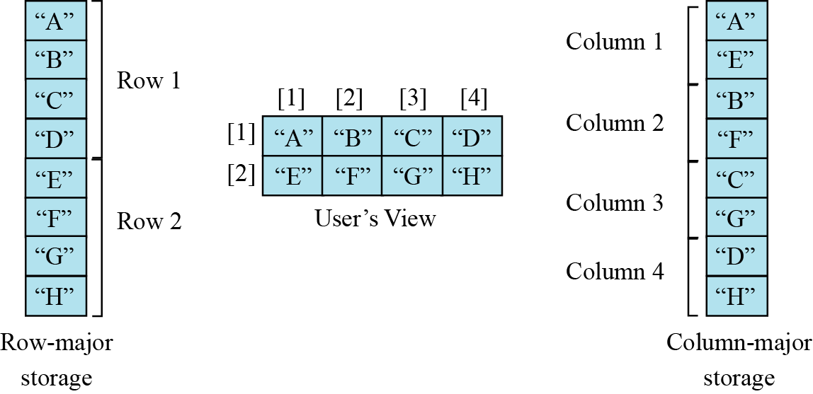
11.1.3 Memory layout
The indexes in a one-dimensional array directly define the relative positions of the element in actual memory. Figure 11.6 shows a two-dimensional array and how it is stored in memory using row-major or column-major storage. Row-major storage is more common.
Figure 11.6 Memory layout of arrays

Slide 14
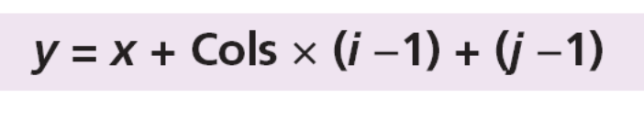
Example 11.4
We have stored the two-dimensional array students in memory. The array is 100 × 4 (100 rows and 4 columns). Show the address of the element students[5][3] assuming that the element student[1][1] is stored in the memory location with address 1000 and each element occupies only one memory location. The computer uses row-major storage.
Solution
We can use the following formula to find the location of an element, assuming each element occupies one memory location.
If the first element occupies the location 1000, the target element occupies the location 1018.

Slide 15
11.1.4 Operations on array
Although we can apply conventional operations defined for each element of an array (see Chapter 4), there are some operations that we can define on an array as a data structure. The common operations on arrays as structures are searching, insertion, deletion, retrieval, and traversal.
Although searching, retrieval, and traversal of an array is an easy job, insertion and deletion is time consuming. The elements need to be shifted down before insertion and shifted up after deletion.

Slide 16
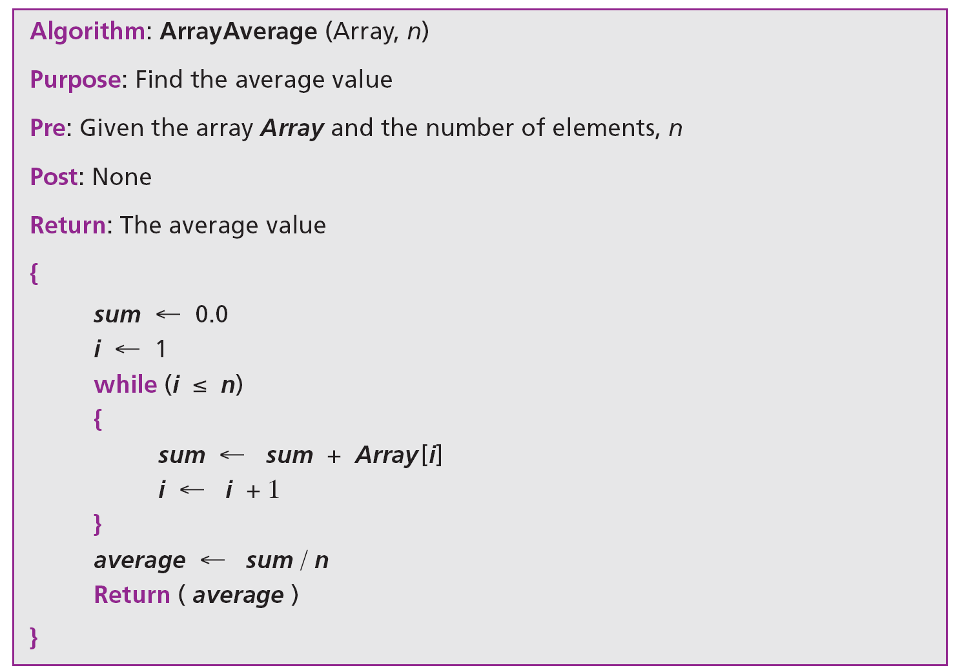
Algorithm 11.1 gives an example of finding the average of elements in array whose elements are reals.

Slide 17
11.1.5 Strings
A string as a set of characters is treated differently in different languages. In C, a string is an array of characters. In C++, a string can be an array of characters, but there is a type name string. In Java, a string is a type.

Slide 18

11.1.6 Application
Thinking about the operations discussed in the previous section gives a clue to the application of arrays. If we have a list in which a lot of insertions and deletions are expected after the original list has been created, we should not use an array. An array is more suitable when the number of deletions and insertions is small, but a lot of searching and retrieval activities are expected.
An array is a suitable structure when a small number of insertions and deletions are required, but a lot of searching and retrieval is needed.

Slide 19

11-2 RECORDS
A record is a collection of related elements, possibly of different types, having a single name. Each element in a record is called a field. A field is the smallest element of named data that has meaning. A field has a type, and exists in memory. Fields can be assigned values, which in turn can be accessed for selection or manipulation. A field differs from a variable primarily in that it is part of a record.
The elements in a record can be of the same or different types, but all elements in the record must be related.

Slide 20
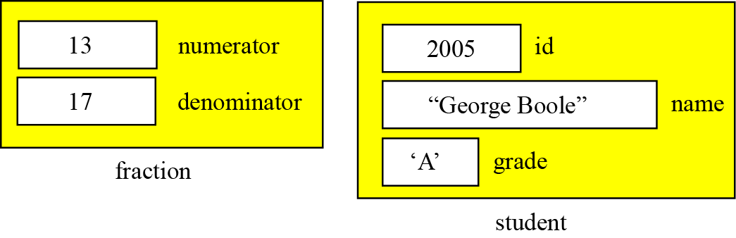
Figure 11.7 contains two examples of records. The first example, fraction, has two fields, both of which are integers. The second example, student, has three fields made up of three different types.
Figure 11.7 Records

Slide 21
11.2.1 Record name versus field name
Just like in an array, we have two types of identifier in a record: the name of the record and the name of each individual field inside the record. The name of the record is the name of the whole structure, while the name of each field allows us to refer to that field. For example, in the student record of Figure 11.7, the name of the record is student, the name of the fields are student.id, student.name, and
student.grade. Most programming languages use a period (.) to separate the name of the structure (record) from the name of its components (fields). This is the convention we use in this book.

Slide 22
Example 11.5
The following shows how the value of fields in Figure 11.7 are stored.

Slide 23
11.2.2 Comparison of records and arrays
We can conceptually compare an array with a record. This helps us to understand when we should use an array and when a record. An array defines a combination of elements, while a record defines the identifiable parts of an element. For example, an array can define a class of students (40 students), but a record defines different attributes of a student, such as id, name, or grade.

Slide 24
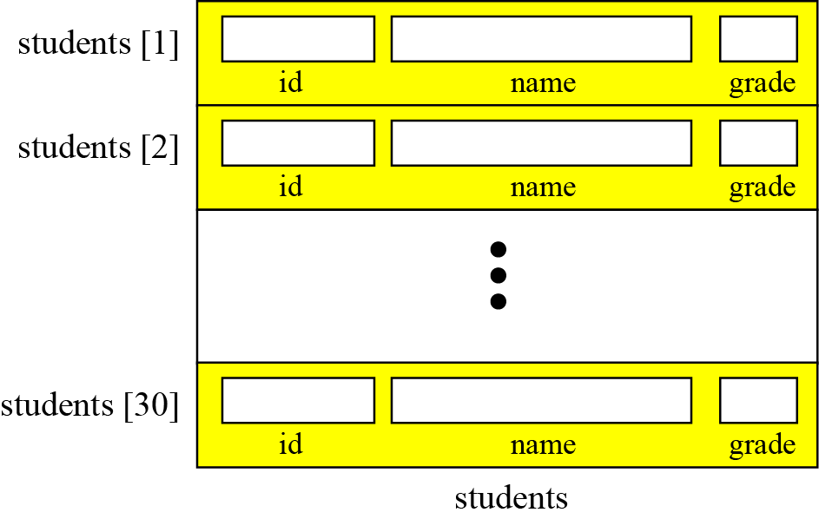
11.2.3 Array of records
If we need to define a combination of elements and at the same time some attributes of each element, we can use an array of records. For example, in a class of 30 students, we can have an array of 30 records, each record representing a student.
Figure 11.8 Array of records

Slide 25
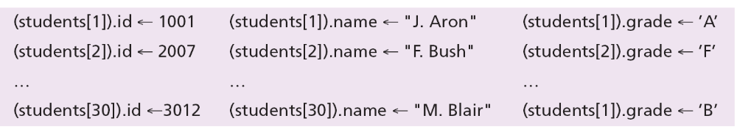
Example 11.6
The following shows how we access the fields of each record in the students array to store values in them.

Slide 26
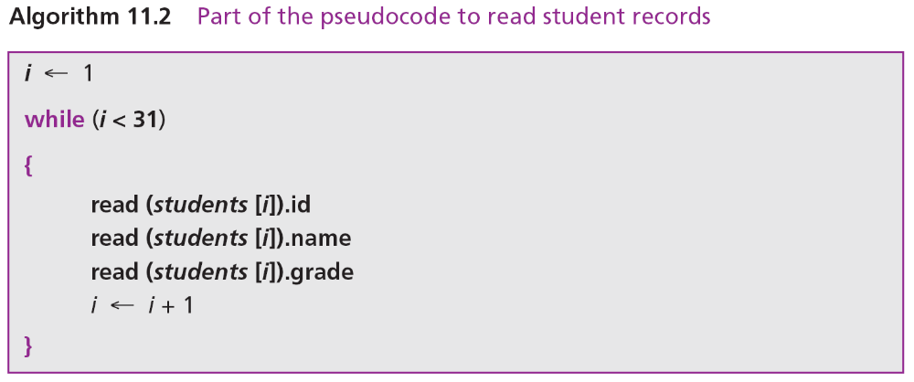
Example 11.7
However, we normally use a loop to read data into an array of records. Algorithm 11.2 shows part of the pseudocode for this process.

Slide 27
11.2.4 Arrays versus arrays of records
Both an array and an array of records represent a list of items. An array can be thought of as a special case of an array of records in which each element is a record with only a single field.

Slide 28
11-3 LINKED LISTS
A linked list is a collection of data in which each element contains the location of the next element—that is, each element contains two parts: data and link. The name of the list is the same as the name of this pointer variable. Figure 11.9 shows a linked list called scores that contains four elements. We define an empty linked list to be only a null pointer: Figure 11.9 also shows an example of an empty linked list.

Slide 29
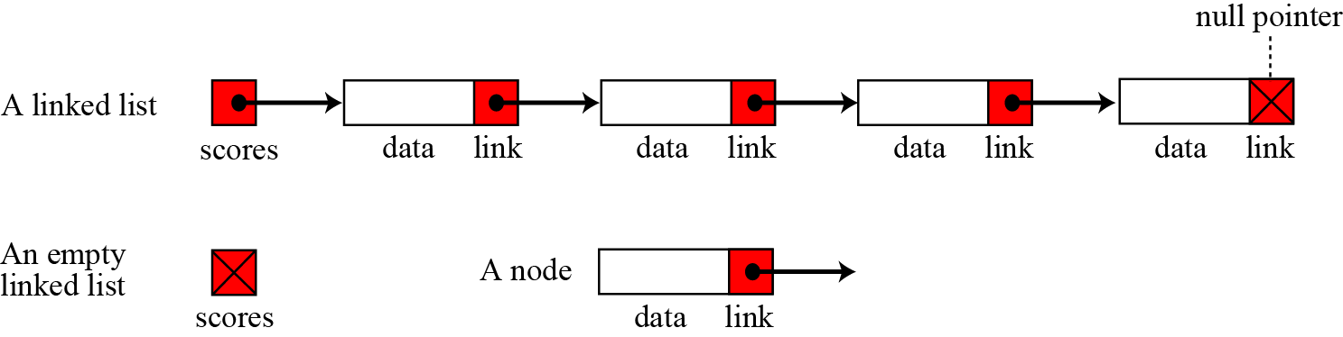
Figure 11.9 Linked lists

Slide 30
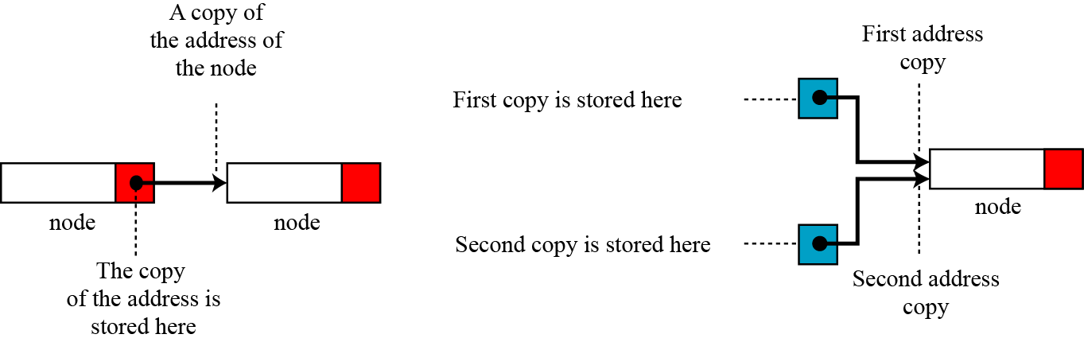
Before further discussion of linked lists, we need to explain the notation we use in the figures. We show the connection between two nodes using a line. One end of the line has an arrowhead, the other end has a solid circle.
Figure 11.10 The concept of copying and storing pointers

Slide 31
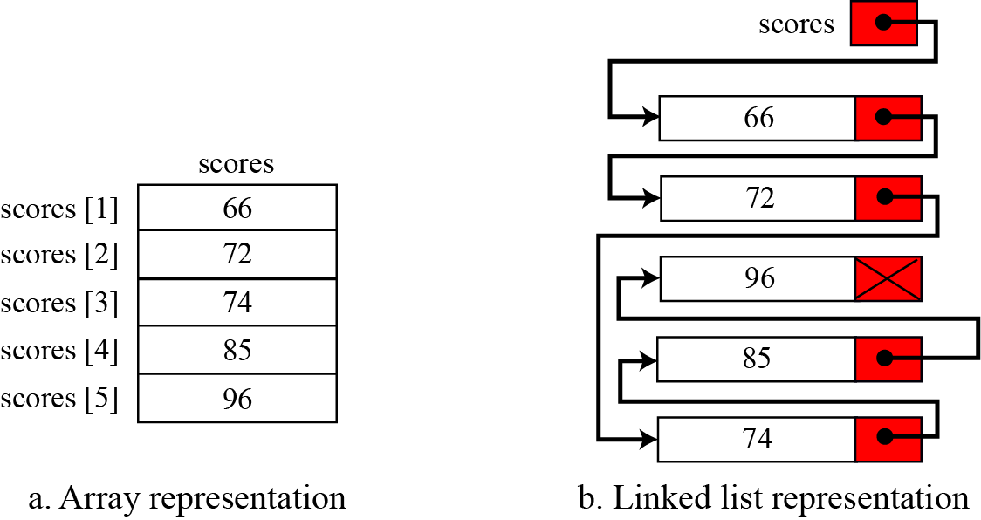
11.3.1 Arrays versus linked lists
Both an array and a linked list are representations of a list of items in memory. The only difference is the way in which the items are linked together. Figure 11.11 compares the two representations for a list of five integers.
Figure 11.11 Array versus linked list

Slide 32
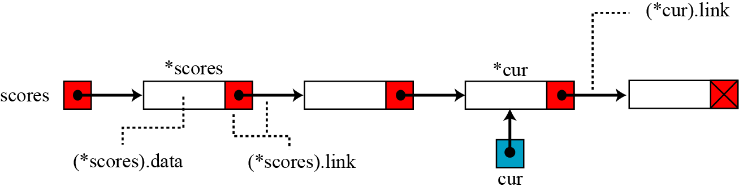
11.3.2 Linked list names versus nodes names
As for arrays and records, we need to distinguish between the name of the linked list and the names of the nodes, the elements of a linked list. A linked list must have a name. The name of a linked list is the name of the head pointer that points to the first node of the list. Nodes, on the other hand, do not have an explicit names in a linked list, just implicit ones.
Figure 11.12 The name of a linked list versus the names of nodes

Slide 33
11.3.3 Operations on linked lists
The same operations we defined for an array can be applied to a linked list.
Searching a linked list
Since nodes in a linked list have no names, we use two pointers, pre (for previous) and cur (for current). At the beginning of the search, the pre pointer is null and the cur pointer points to the first node. The search algorithm moves the two pointers together towards the end of the list. Figure 11.13 shows the movement of these two pointers through the list in an extreme case scenario: when the target value is larger than any value in the list.

Slide 34
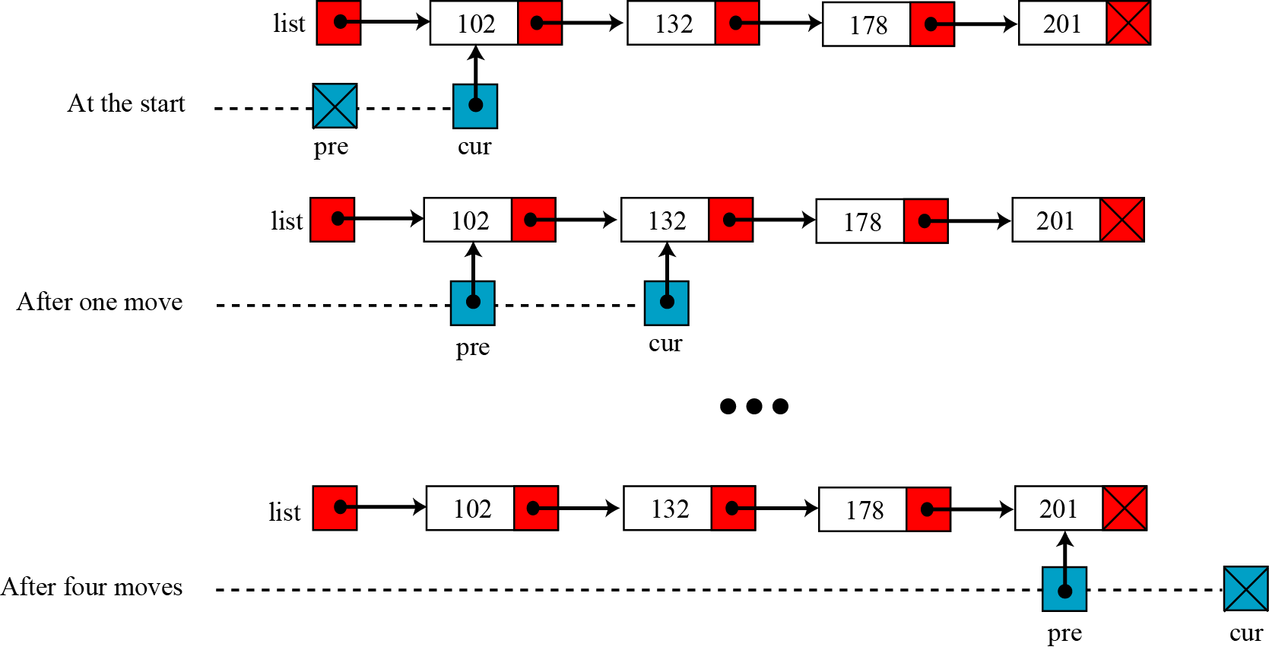
Figure 11.13 Moving of pre and cur pointers in searching a linked list

Slide 35
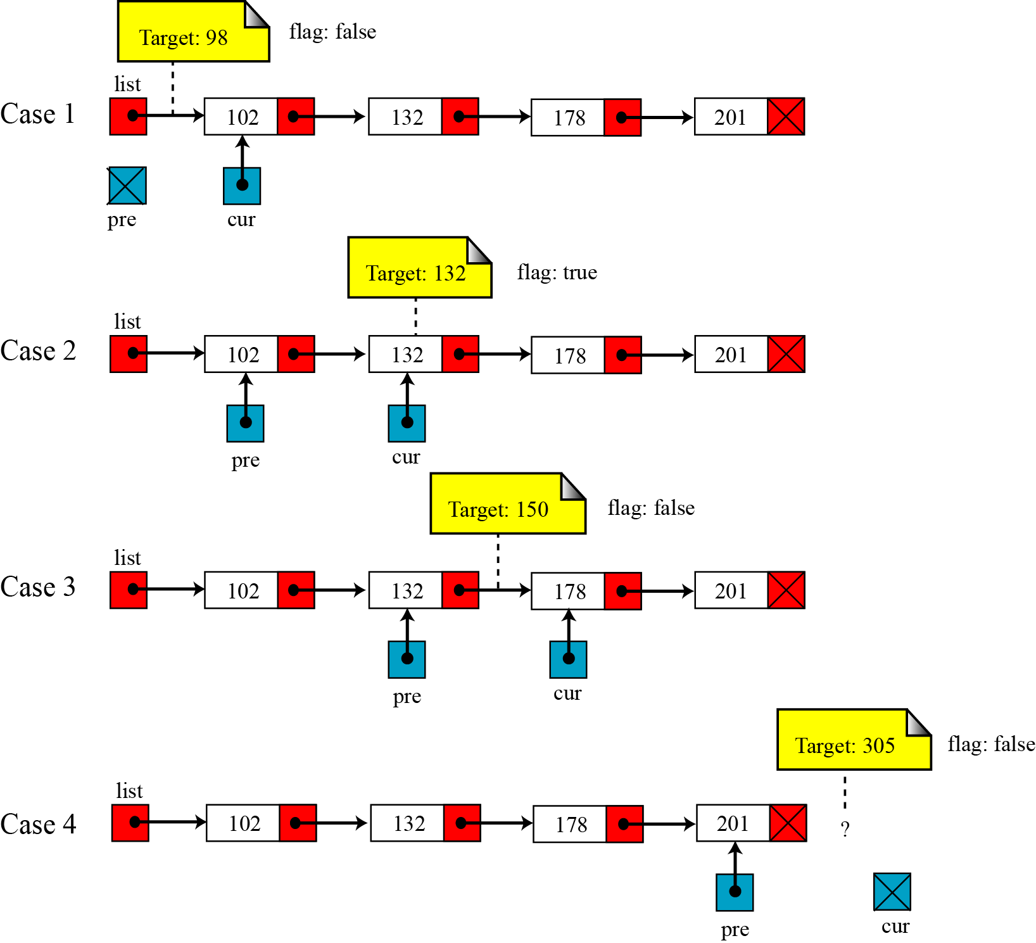
Figure 11.14 Values of pre and cur pointers in different cases

Slide 36
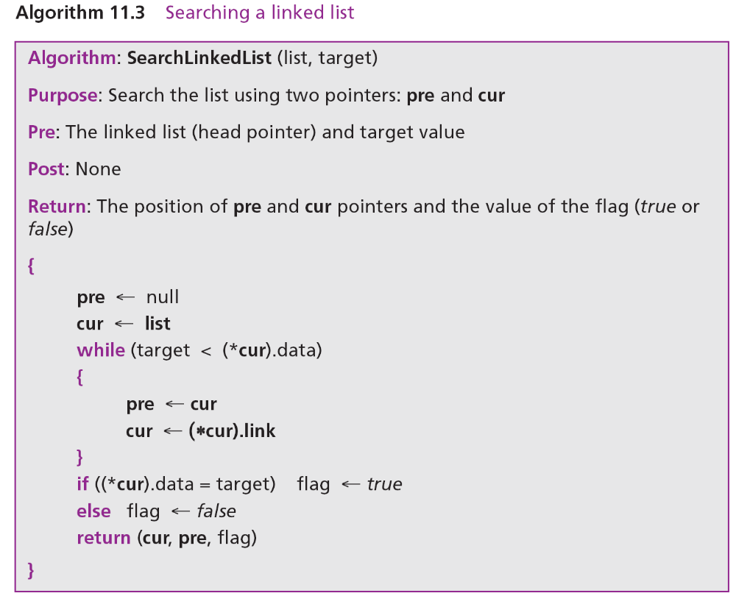

Slide 37
Inserting a node
Before insertion into a linked list, we first apply the searching algorithm. If the flag returned from the searching algorithm is false, we will allow insertion, otherwise we abort the insertion algorithm, because we do not allow data with duplicate values. Four cases can arise:
Inserting into an empty list.
Insertion at the beginning of the list.
Insertion at the end of the list.
Insertion in the middle of the list.

Slide 38
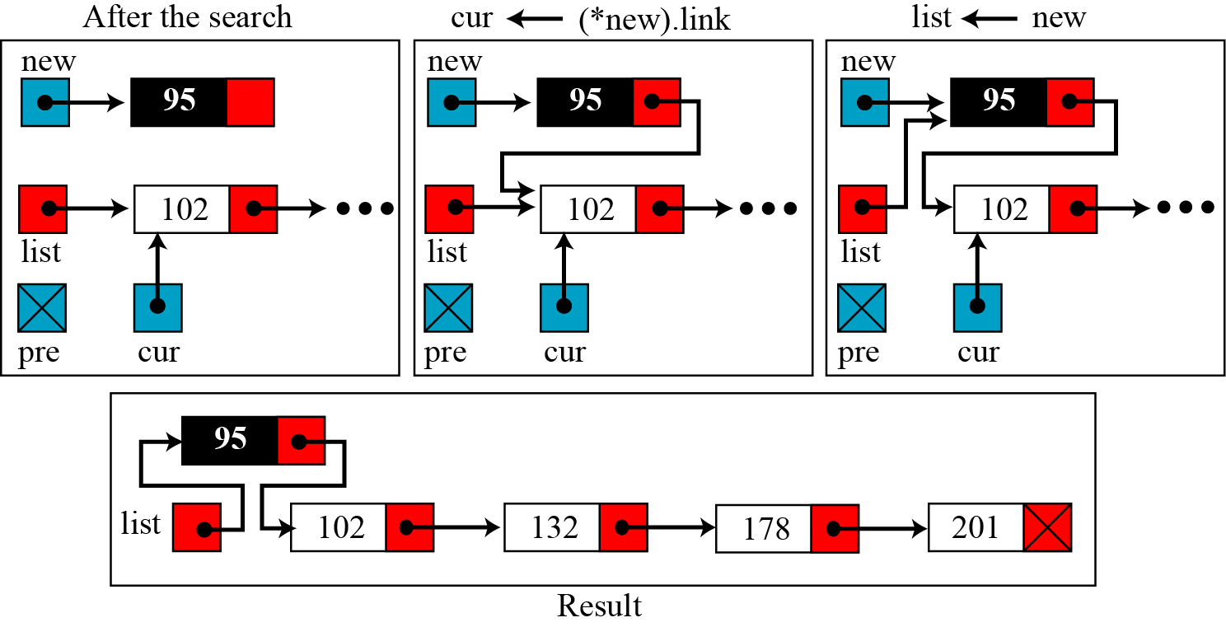
Figure 11.15 Inserting a node at the beginning of a linked list

Slide 39
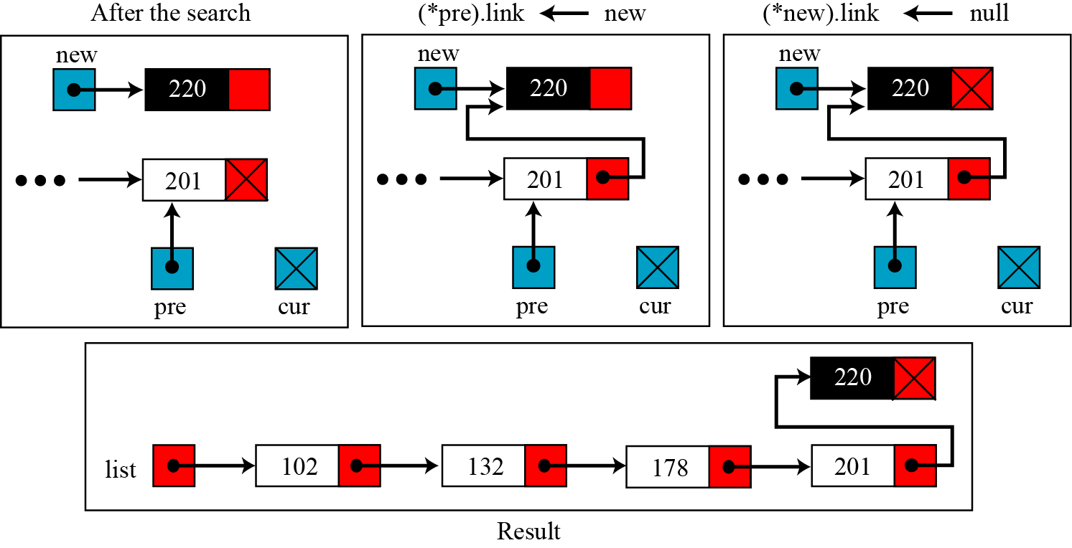
Figure 11.16 Inserting a node at the end of the linked list

Slide 40
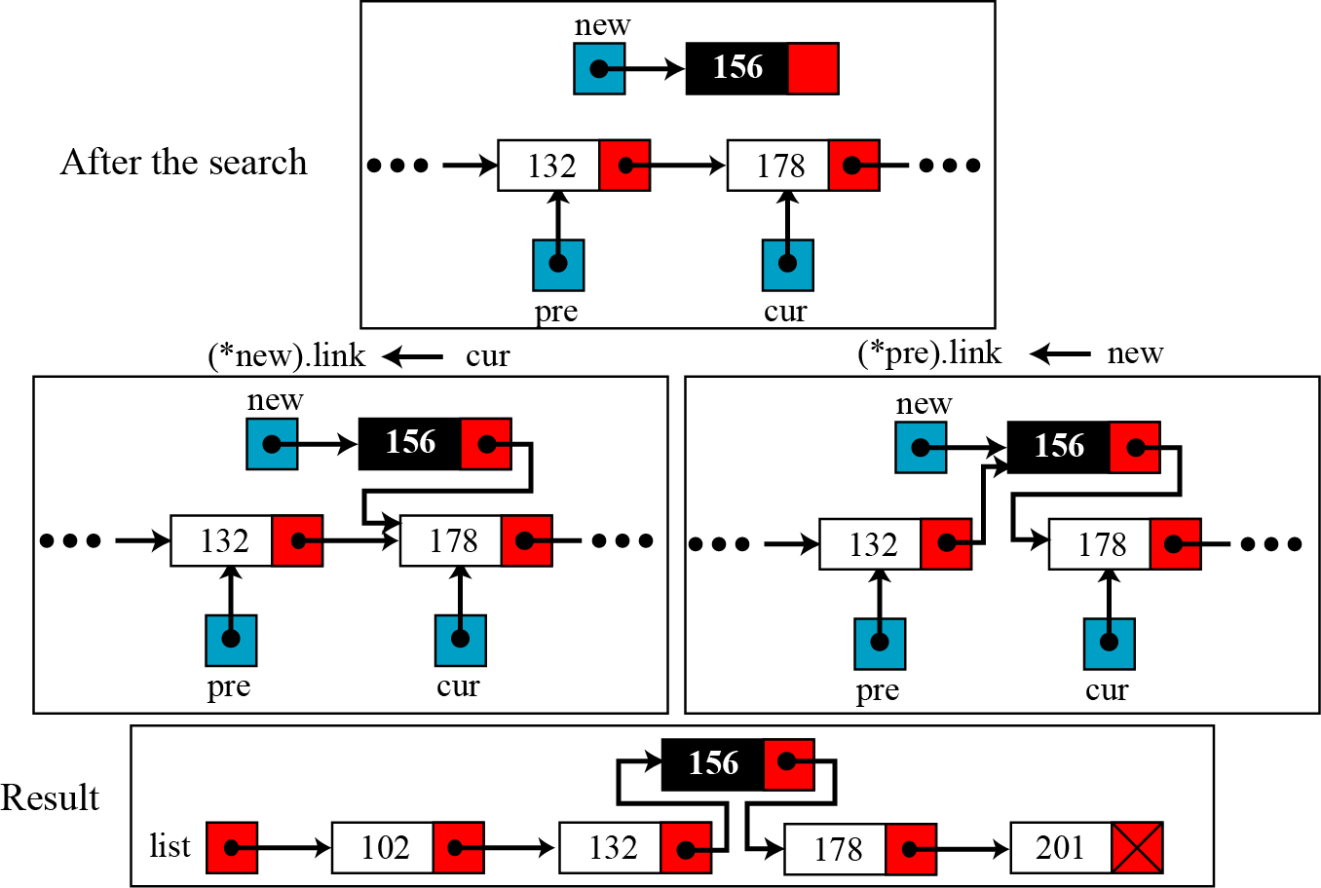
Figure 11.17 Inserting a node in the middle of the linked list

Slide 41
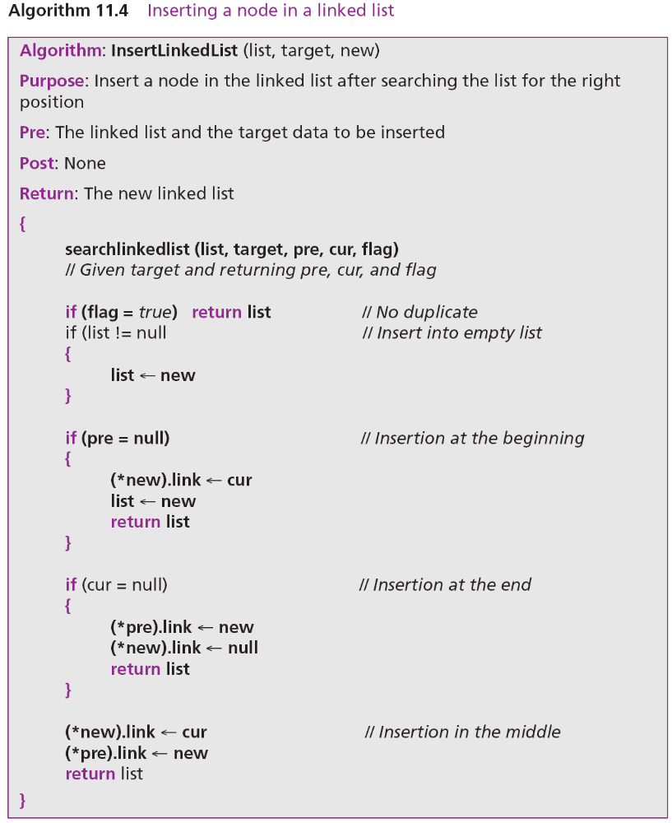

Slide 42
Deleting a node
Before deleting a node in a linked list, we apply the search algorithm. If the flag returned from the search algorithm is true (the node is found), we can delete the node from the linked list. However, deletion is simpler than insertion: we have only two cases—deleting the first node and deleting any other node. In other words, the deletion of the last and the middle nodes can be done by the same process.

Slide 43
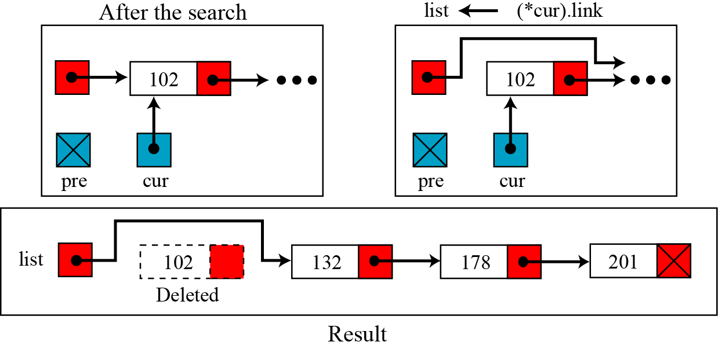
Figure 11.18 Deleting the first node of a linked list

Slide 44
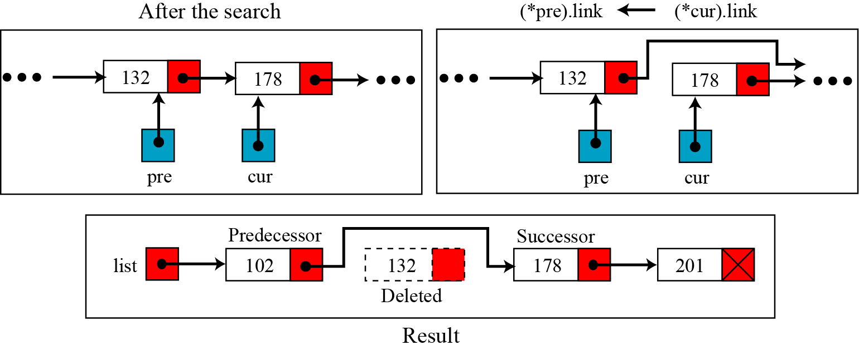
Figure 11.19 Deleting a node at the middle or end of a linked list

Slide 45
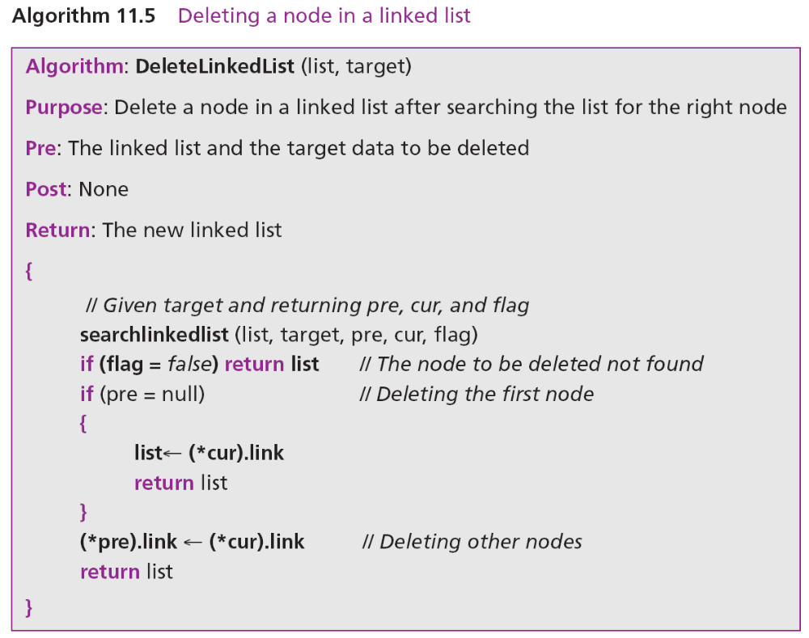

Slide 46
Retrieving a node
Retrieving means randomly accessing a node for the purpose of inspecting or copying the data contained in the node. Before retrieving, the linked list needs to be searched. If the data item is found, it is retrieved, otherwise the process is aborted. Retrieving uses only the cur pointer, which points to the node found by the search algorithm. Algorithm 11.6 shows the pseudocode for retrieving the data in a node. The algorithm is much simpler than the insertion or deletion algorithm.

Slide 47
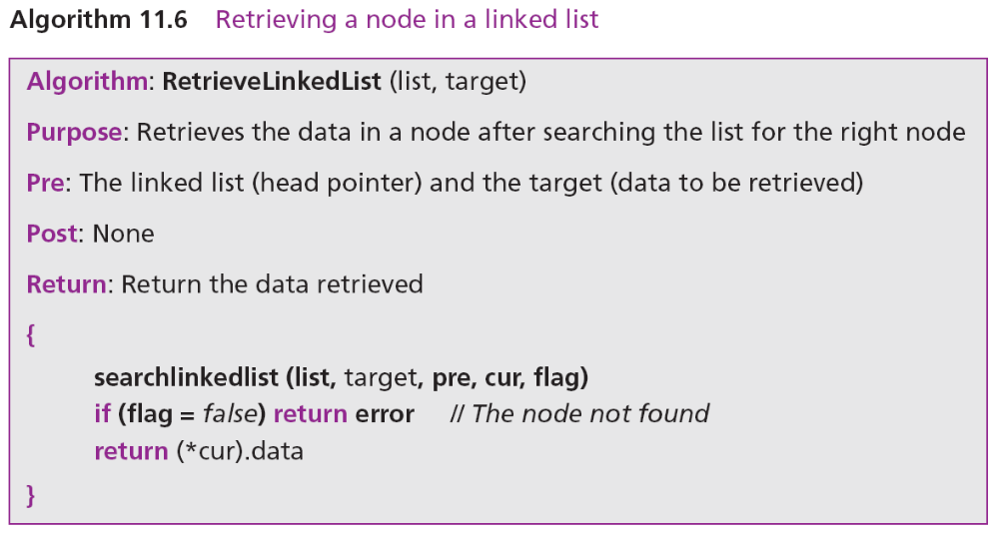

Slide 48
Traversing a linked list
To traverse the list, we need a “walking” pointer, which is a pointer that moves from node to node as each element is processed. We start traversing by setting the walking pointer to the first node in the list. Then, using a loop, we continue until all of the data has been processed. Each iteration of the loop processes the current node, then advances the walking pointer to the next node. When the last node has been processed, the walking pointer becomes null and the loop terminates (Figure 11.20).

Slide 49
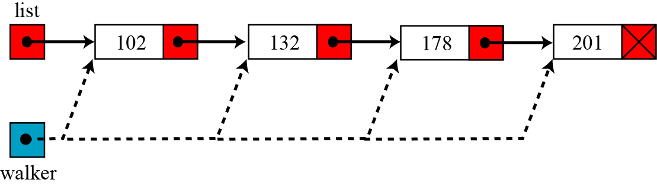
Figure 11.20 Traversing a linked list

Slide 50
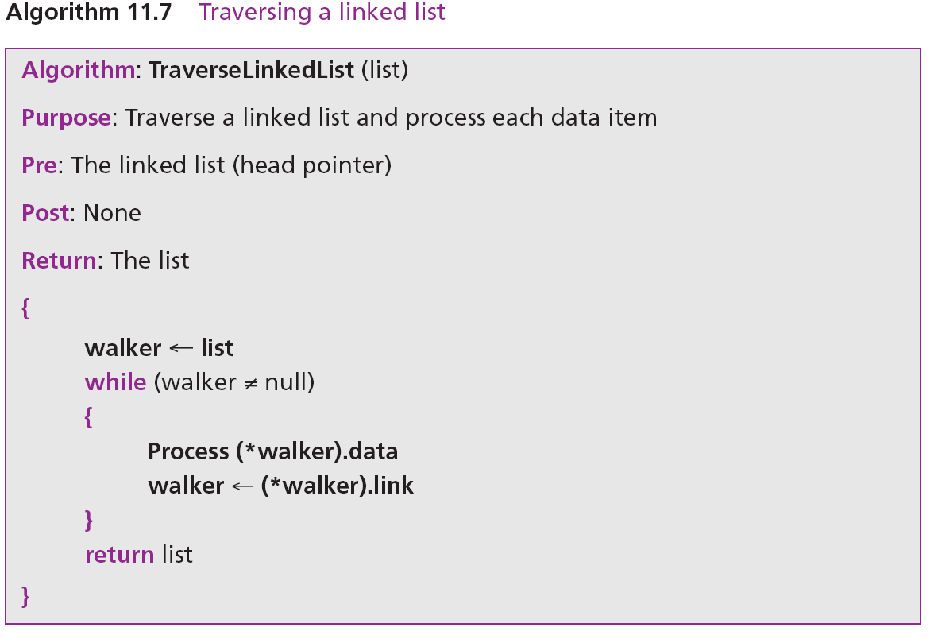

Slide 51

11.3.4 Applications of linked lists
A linked list is a very efficient data structure for sorted list that will go through many insertions and deletions. A linked list is a dynamic data structure in which the list can start with no nodes and then grow as new nodes are needed. A node can be easily deleted without moving other nodes, as would be the case with an array. For example, a linked list could be used to hold the records of students in a school. Each quarter or semester, new students enroll in the school and some students leave or graduate.
A linked list is a suitable structure if a large number of insertions and deletions are needed, but searching a linked list is slower that searching an array.

